Slide 1

Silicon Photonic Accelerated Memory Pooling For Efficient Compute Resource Allocation
Zhenguo Wu and Keren Bergman
zw2542@columbia.edu
Lightwave Research Laboratory
Columbia University, New York, NY
Aug 20th, 2025

Slide 2
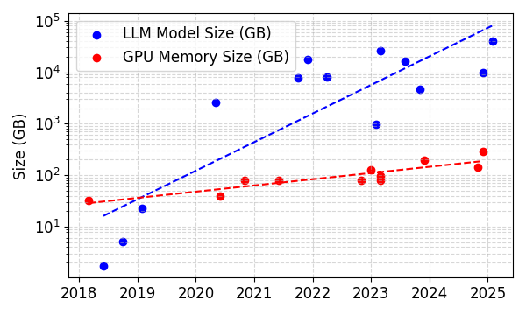
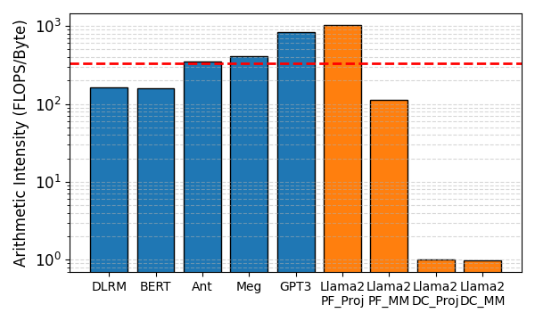
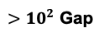
Memory Challenges in Scaling Large Language Models
GPU Memory Limitations
The growth rate of high-bandwidth memory (HBM) per GPU is much slower than the rapid scaling of Large Language Models (LLMs).
The growing gap limits batch size scaling and adds distributed training/inference complexity.
Arithmetic Intensity Variations
LLM models exhibit diverse arithmetic intensities across workloads for training and inference, as well as between the prefill and decode stages of inference.
Each workload (or stage) imposes unique demands on compute power and memory bandwidth.
H100 OPs:Bytes
Compute Bound
Memory Bound
$>10^{2}$ Gap
Training
Inference

Slide 3
Current Compute & Memory Pooling Architecture
SoTA Compute Architecture
Current Memory Pooling Architecture
HBM
HBM
HBM
Compute Pool
Memory Pool
SOTA GPU
Mem
Mem
GPU
GPU
Electrical Interconnect
Mem
Mem
PCIe
Electrical I/O
Mem
Mem
GPU
GPU
HBM
HBM
HBM
Mem
Mem
HBMs are placed around the periphery of the compute die using short-reach electrical I/Os.
HBM’s wide I/O and high pin count requires short electrical traces, restricting it to areas near the compute die.
Compute die's periphery length restricts the number of HBMs that can be integrated locally.
Limited memory capacity scaling.
Memory Pooling: compute pool connects to memory pool via a high-speed electrical interconnect.
Local HBMs serve as high-bandwidth memory suppliers (lower capacity).
Remote memory units (e.g., DDR, GDDR) act as capacity expanders via an electrically interconnected fabric.

Slide 4
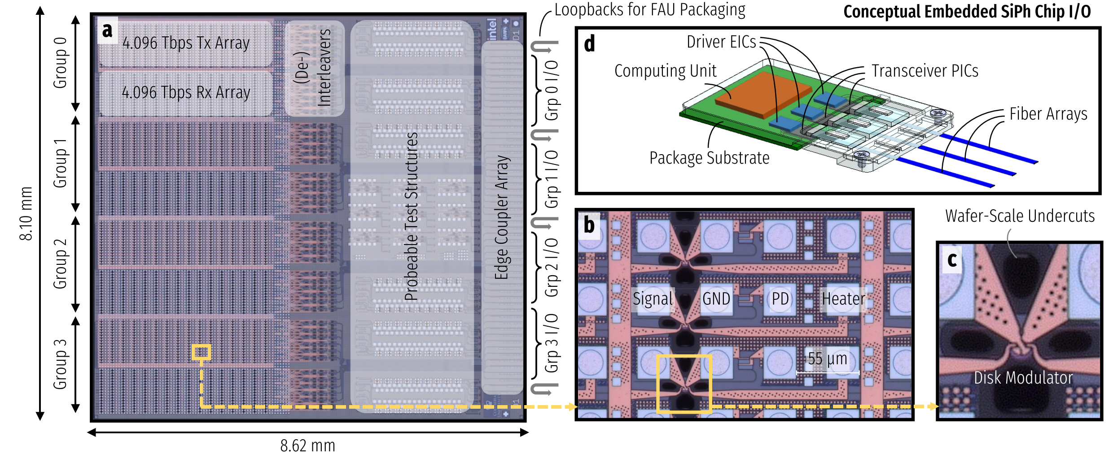
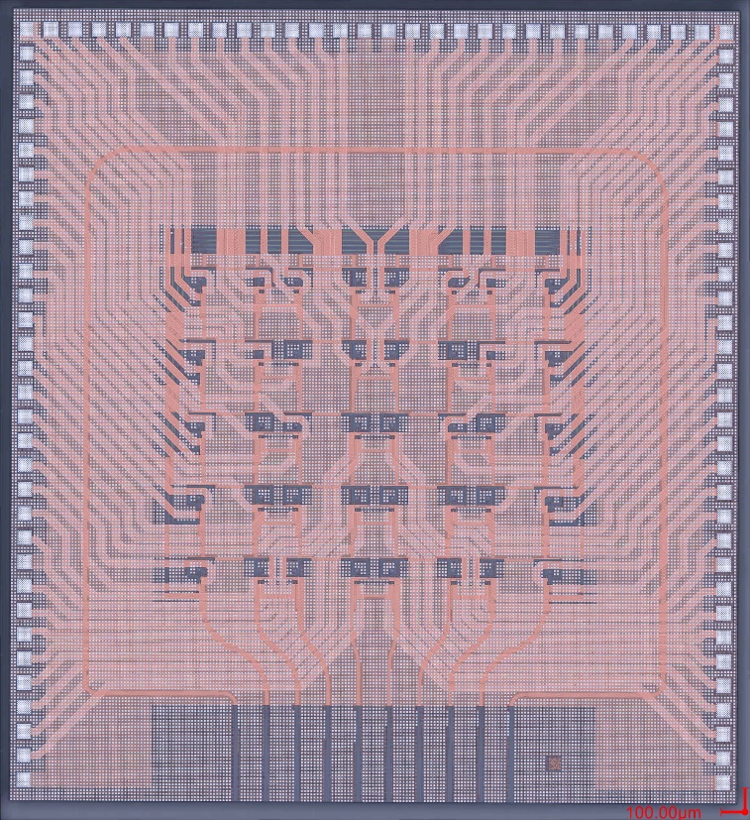
Enabling Silicon Photonic Technologies
Embedded Photonic Transceiver
Co-Packaged/Embedded Photonic I/Os
1. Massively parallel bandwidth
Data
Data
Data
Micro-ring resonator (MRR)
2. Distance-independent scaling
Comb
Laser
Modulated Signals
Custom Designed Transceiver PIC [1]
Optical Circuit Switches
In₁
Custom Designed Switch PIC [2]
Total = 16 Tbps
In₂
In₃
Out₁
Out₂
Out₃
[1] Wang, Yuyang, et al. “Co-designed silicon photonics chip i/o for energy-efficient petascale connectivity.” IEEE Transactions on Components, Packaging and Manufacturing Technology. IEEE, 2024
[2] Dai, Liang Yuan, et al. "Ultra-scalable microring-based architecture for spatial-and-wavelength selective switching." 2023 IEEE Silicon Photonics Conference (SiPhotonics). IEEE, 2023.

Slide 5


Expanding the Memory Pooling Design Space
Compute die’s shoreline width is used a critical resource.
HBM
HBM
HBM
﻿Conceptual Embedded SiP Chip I/O
HBM
HBM
HBM
SOTA GPU
Semi-Disaggregated GPU
PCIe
Electrical I/O
PCIe
SiP I/O
Designed and fabricated transceiver PIC
HBM
HBM
HBM
SiP I/O
HBM
HBM
HBM
SiP I/O
Fully Disaggregated GPU
(Total ~ 30 TBps = 240 Tbps)
SiP I/O Embedded GPU
Total = 2 TBps
(16 Tbps)
PCIe
SiP I/O
PCIe
SiP I/O
SiP I/O
HBM
HBM
HBM
Unified high-bandwidth domain for memory and network communication

Slide 6
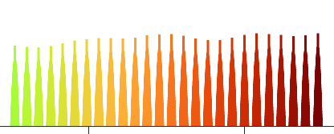
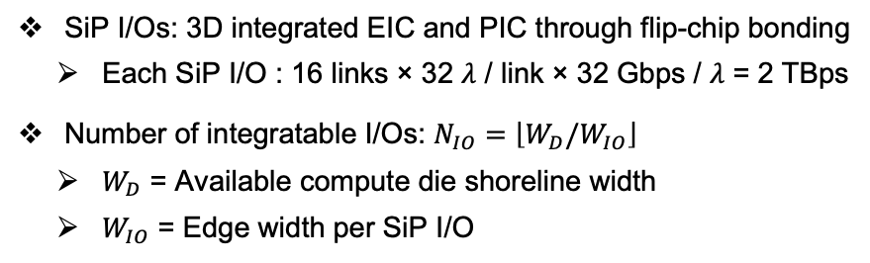
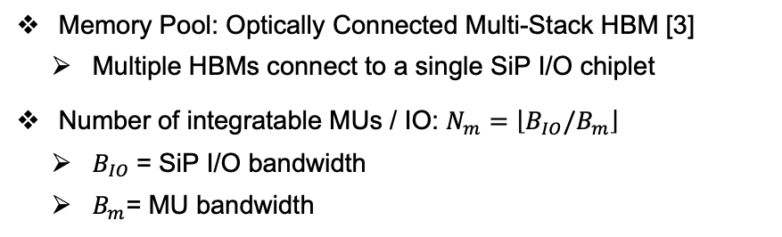
SiPAM: Silicon Photonic Accelerated Memory-Pooling
SiPAM Compute Architecture
b)
EIC-PIC 3D Integration
EIC
EIC
EIC
EIC
EIC
EIC
Frequency
Comb Driven I/Os
Memory Pool
(De-) Interleaver
32-Channel Tx Link 0
PIC
PIC
PIC
PIC
PIC
PIC
PIC
EIC
HBM
HBM
HBM
…
32-Channel Rx Link 0
Fully Disaggregated
Compute Unit
EIC
PIC
Fiber Array
PIC
(De-) Interleaver
32-Channel Tx Link 1
EIC
HBM
HBM
HBM
…
32-Channel Rx Link 1
PCIe
EIC
PIC
Flip-chip
…
…
PIC
16 links
EIC
HBM
HBM
HBM
…
32-Channel Tx Link 0
EIC
~8 mm
shoreline
PIC
32-Channel Rx Link 0
PIC
(De-)Interleaver Control
Compute/Mem Interface
EIC
EIC
EIC
EIC
EIC
EIC
EIC
…
32-Channel Tx Link 1
PIC
PIC
PIC
PIC
PIC
PIC
16 x 32λ x 32 Gbps
= 2 TBps / IO
PIC
HBM
HBM
HBM
32-Channel Rx Link 1
EIC
…
SiP I/Os: 3D integrated EIC and PIC through flip-chip bonding
Each SiP I/O : 16 links × 32 $λ$ / link × 32 Gbps / $λ$ = 2 TBps
Number of integratable I/Os: $N_{IO}=\left\lfloor W_{D}/W_{IO}\right\rfloor$
$W_{D}$ = Available compute die shoreline width
$W_{IO}$ = Edge width per SiP I/O
Memory Pool: Optically Connected Multi-Stack HBM [3]
Multiple HBMs connect to a single SiP I/O chiplet
Number of integratable MUs / IO: $N_{m}=\left\lfloor B_{IO}/B_{m}\right\rfloor$
$B_{IO}$= SiP I/O bandwidth
$B_{m}$= MU bandwidth
[3] Ou, Y., Zhang, H., Rovinski, A., Wentzlaff, D., & Batten, C. (2025). Optically Connected Multi-Stack HBM Modules for Large Language Model Training and Inference. IEEE Computer Architecture Letters.

Slide 7
SiPAM: Silicon Photonic Accelerated Memory-Pooling
SiPAM Network Topology
d)
WSS
WSS
WSS
WSS
WSS
WSS
WSS
WSS
WSS
WSS
WSS
WSS
WSS
WSS
WSS
WSS
OCS
OCS
OCS
OCS
OCS
OCS
OCS
OCS
Optical Switches
Optical Switches
Memory Tray
CU
Memory Tray
Memory Tray
CU
CU
CU
CU
CU
CU
CU
CU
CU
CU
CU
CU
CU
CU
CU
SiPAM Rack
Optical Interconnect
Memory Interface
Compute Tray
Compute Tray
Compute Trays
MU
MU
MU
MU
MU
Compute Tray
OCS
OCS
OCS
OCS
OCS
OCS
Compute Tray
Each SiP I/O can be flexibly allocated for high-speed memory access or network communication.
One-shot reconfiguration per workload.
SiPAC’s physical design: replaces electrical packet switches (EPS) with optical circuit switches (OCS) in a BCube topology
Intra-rack resource disaggregation model [4] for a bounded increase in memory latency.
CXL is a promising memory semantic interconnect technology:
Increased memory latency can be mitigated by increasing CXL bandwidth when the memory system is fully loaded [5].
[4] Michelogiannakis, George, et al. "Efficient intra-rack resource disaggregation for HPC using co-packaged DWDM photonics." 2023 IEEE International Conference on Cluster Computing (CLUSTER). IEEE, 2023.
[5] Cho, A., Saxena, A., Qureshi, M., & Daglis, A. (2024, November). COAXIAL: A CXL-centric memory system for scalable servers. In SC24.

Slide 8
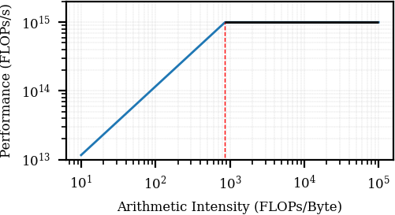
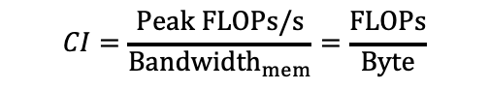
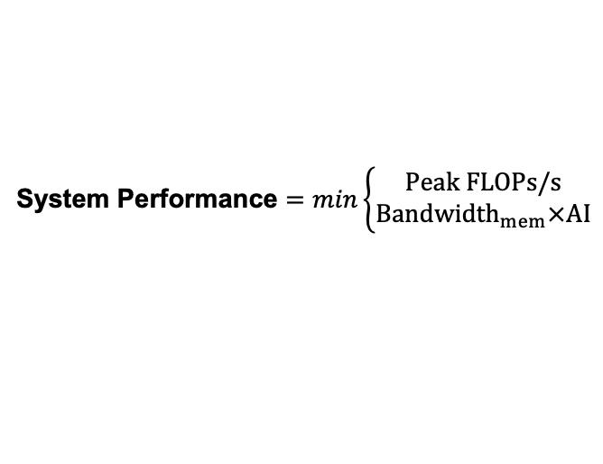
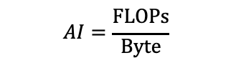
Optimization Methodology
Goal: Determine the optimal configuration for compute power, memory bandwidth, and capacity for each workload.
Hardware
Compute Intensity (CI): # of required FLOPs per byte of data loaded to keep cores active.
System Performance $=min\left\{\begin{aligned}Peak FLOPs/s \\ Bandwidth_{mem}×AI\end{aligned}\right.$
Roofline Model
$$CI=\frac{Peak FLOPs/s}{Bandwidth_{mem}}=\frac{FLOPs}{Byte}$$
Peak FLOPs/s
Memory Bandwidth
Design CI = AI
Workload
(reconfigurable)
Arithmetic Intensity (AI): # of actual FLOPs performed for each byte of data loaded.
Memory Bound
Compute Bound
$$AI=\frac{FLOPs}{Byte}$$
CI

Slide 9
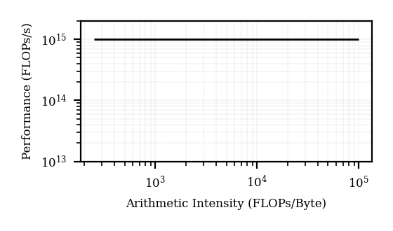
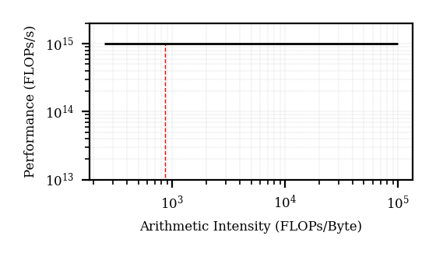
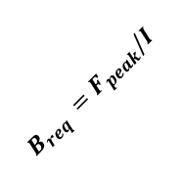
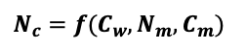
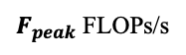
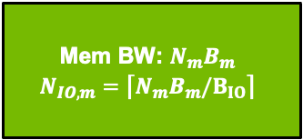
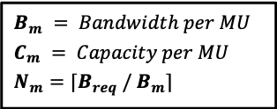
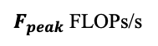
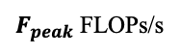
Optimization Methodology
Goal: Determine the optimal configuration for compute power, memory bandwidth, capacity for each workload.
(1)
Peak Compute FLOPs
(2)
Workload Arithmetic Intensity
(3)
Required Memory Bandwidth
$F_{peak}$ FLOPs/s
$F_{peak}$ FLOPs/s
$F_{peak}$ FLOPs/s
I FLOPs/Byte
$$B_{req} =F_{peak}/I$$
I FLOPs/Byte
(4)
Number of memory units to satisfy memory bandwidth requirement
(5)
Distribution of SiP I/Os for memory and network communication
(6)
Number of CUs + parallelisms
$$B_{m} = Bandwidth per MU$$
$$C_{m} = Capacity per MU$$
$$N_{m}=\text{⌈}B_{req} / B_{m}\text{⌉}$$
Mem BW: $N_{m}B_{m}$
$$N_{IO,m}=\text{⌈}N_{m}B_{m}/B_{IO}\text{⌉}$$
MU
MU
PCIe
$$N_{c}={f(C}_{w},N_{m}, C_{m})$$
MU
MU
MU
MU
MU
MU
MU
MU
SiP I/O for memory
SiP I/O for network

Slide 10
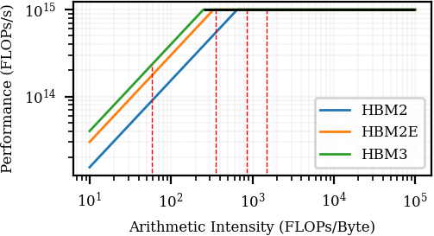
Evaluation Setup – Calculon [6]
Workload & Configurations
Baseline Configuration:
Arithmetic Intensity: profiled using Calculon
Capacity Requirement: profiled using Calculon
Baseline Configuration:
NVLink (scale-up) + InfiniBand (scale-out)
SiPAM Configuration:
SiPAC network
Optimized # GPUs, memory capacity and bandwidth
NIC: up to 800 Gbps / GPU
InfiniBand / Ethernet Network
NIC
NIC
NIC
NIC
NIC
NIC
GPU
GPU
GPU
GPU
GPU
GPU
NVSwitch
NVSwitch
NVSwitch
NVL Domain: up to 72 GPUs
SiPAM Configuration:
SS
SS
SS
SS
SS
SS
SS
SS
SS
OCS
SS
SS
SS
SS
SS
SS
OCS
OCS
OCS
OCS
OCS
OCS
OCS
Megatron-126M
Anthropic-52B
Megatron-1T
GPT3-175B
CU
Memory Tray
CU
CU
CU
CU
CU
CU
CU
CU
CU
CU
CU
CU
CU
CU
CU
Memory Interface
Compute Trays
MU
MU
MU
MU
MU
OCS
OCS
OCS
OCS
OCS
OCS
[6] Isaev, Mikhail, et al. "Calculon: a methodology and tool for high-level co-design of systems and large language models." SC 2023.

Slide 11
Evaluation Setup – Calculon [6]
Hardware – Nvidia GPU Based
Baseline Configuration:
NIC: up to 800 Gbps / GPU
Single CU | FP16 TFLOPs | Mem Cap (GB) | Mem BW (TBps)
Nvidia A100 | 312 | 40 | 1.5
Nvidia H100 | 1000 | 80 | 3
Nvidia B100 | 3500 | 192 | 8
SiPAM* | 3500 | Up to 720 | Up to 30
InfiniBand / Ethernet Network
NIC
NIC
NIC
NIC
NIC
NIC
GPU
GPU
GPU
GPU
GPU
GPU
NVSwitch
NVSwitch
NVSwitch
NVL Domain: up to 72 GPUs
Cluster Size: up to 1024 GPUs
Cluster of 1024 CUs | FP16 PFLOPs | Mem Cap (TB) | Mem BW (PBps)
Nvidia A100 | 320 | 41 | 1.5
Nvidia H100 | 1024 | 82 | 3.1
Nvidia B100 | 3584 | 197 | 8.2
SiPAM* | 3584 | Up to 737 | Up to 31
SiPAM Configuration:
SS
SS
SS
SS
SS
SS
SS
SS
SS
OCS
SS
SS
SS
SS
SS
SS
OCS
OCS
OCS
OCS
OCS
OCS
OCS
CU
Memory Tray
CU
CU
CU
CU
CU
CU
CU
CU
CU
CU
CU
CU
CU
CU
CU
Memory Interface
Compute Trays
MU
MU
MU
MU
MU
OCS
OCS
OCS
OCS
OCS
OCS
* Assuming B100 as CU and HBM3E as MU

Slide 12
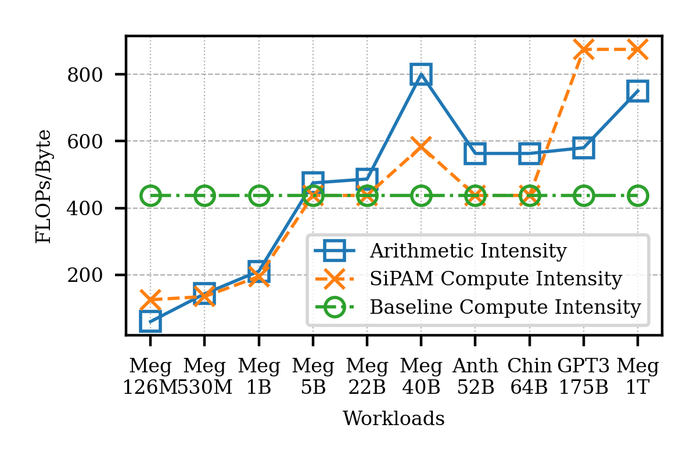
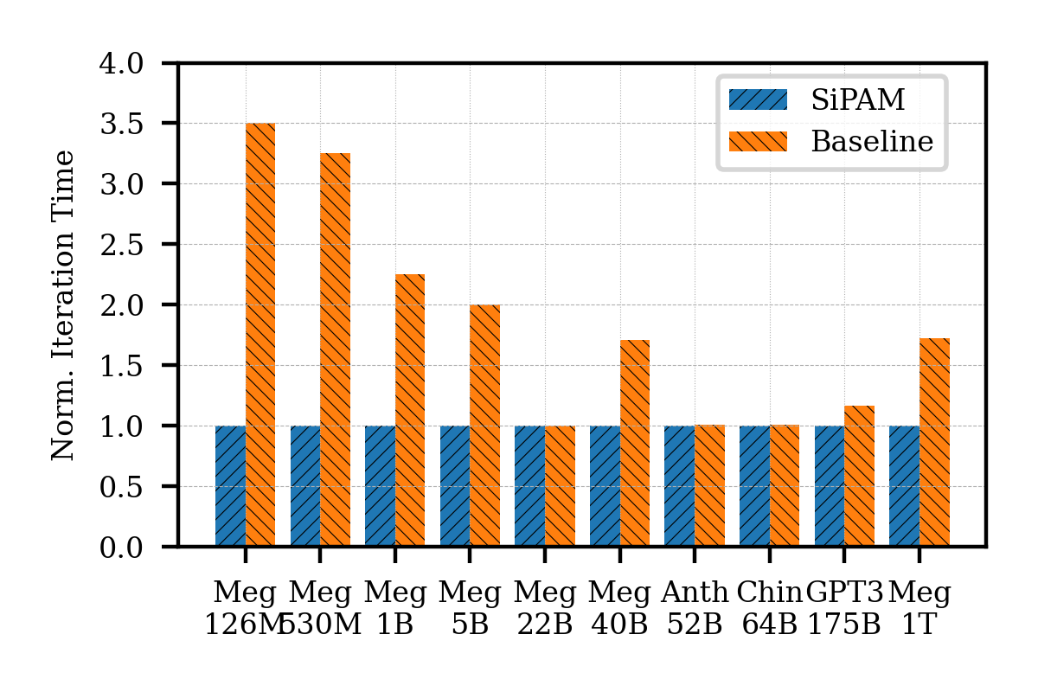
Simulation Results - Training
Workloads: Megatron-126M/5B/22B/40B/1T, Anthropic 52B, Chichilla-64B, GPT3-175B (Training)
Baseline: Up to 256 B100 GPUs each with fixed 192 GB HBM memory @ 8 TBps total memory bandwidth
SiPAM: Up to 256 GPUs, with compute, memory bandwidth, and capacity optimized based on each workload
Lower is Better
SiPAM tracks arithmetic intensity closely, while the baseline remains constant
SiPAM improves training time by up to 3.5x

Slide 13
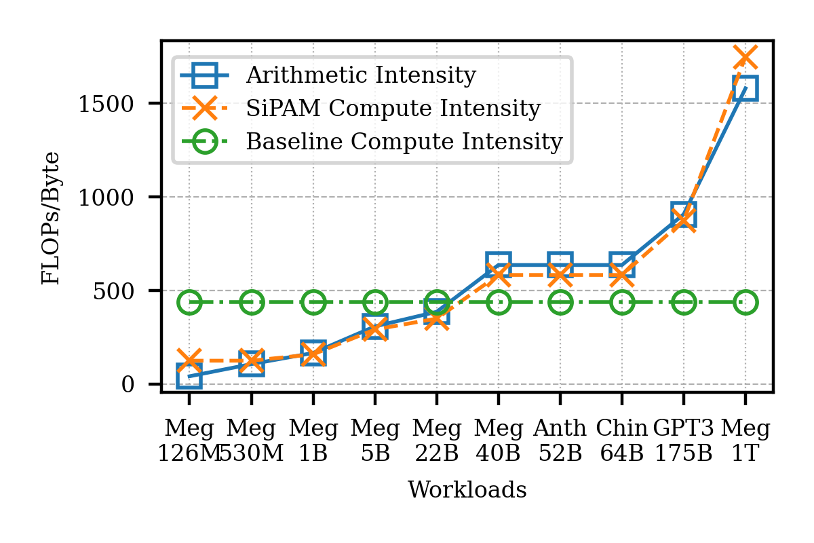
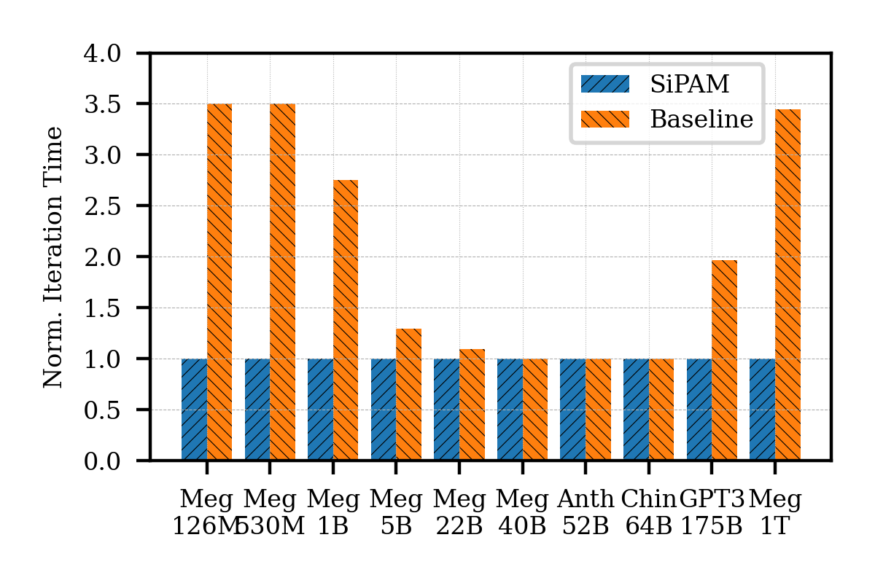
Simulation Results - Inference
Workloads: Megatron-126M/5B/22B/40B/1T, Anthropic 52B, Chichilla-64B, GPT3-175B (Inference)
Baseline: Up to 64 B100 GPUs each with fixed 192 GB HBM memory @ 8 TBps total memory bandwidth
SiPAM: Up to 64 GPUs, with compute, memory bandwidth, and capacity optimized based on each workload
Lower is Better
SiPAM tracks arithmetic intensity closely, while the baseline remains constant
SiPAM improves inference time by up to 3.5x

Slide 14
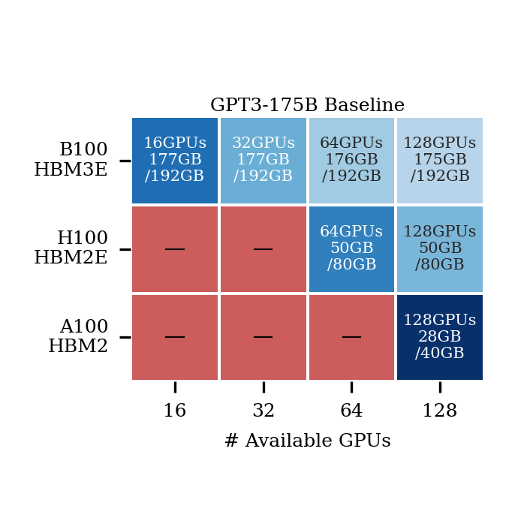
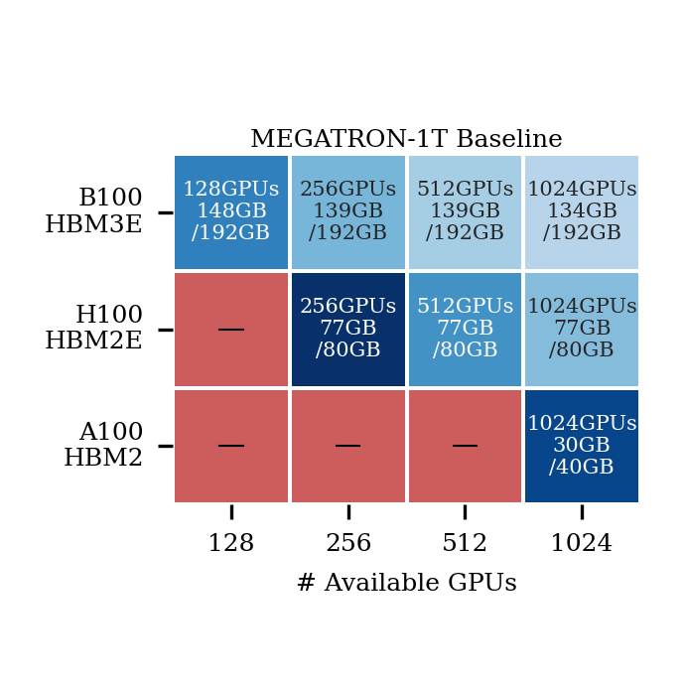
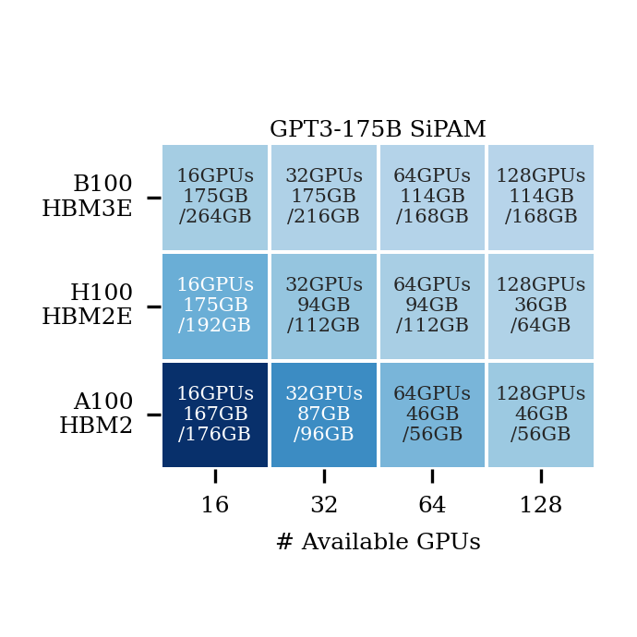
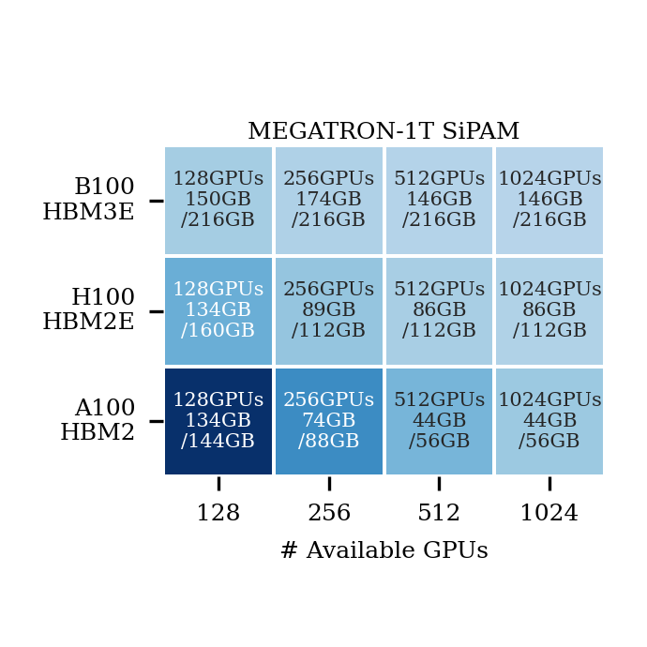
Performance Under Limited Compute Resource
Configurations:
Workload: GPT3-175B and Megatron-1T
Red cells: no feasible parallelization strategy
Darker color: higher iteration time
Takeaway: SiPAM consistently enables feasible deployment of larger models under constrained GPU resources
SiPAM flexibly allocates memory capacity and bandwidth.
For a fixed GPU-HBM combination, iteration time decreases as the number of available GPUs increases.
For a fixed number of GPU, newer GPU generations yield lower iteration time.

Slide 15
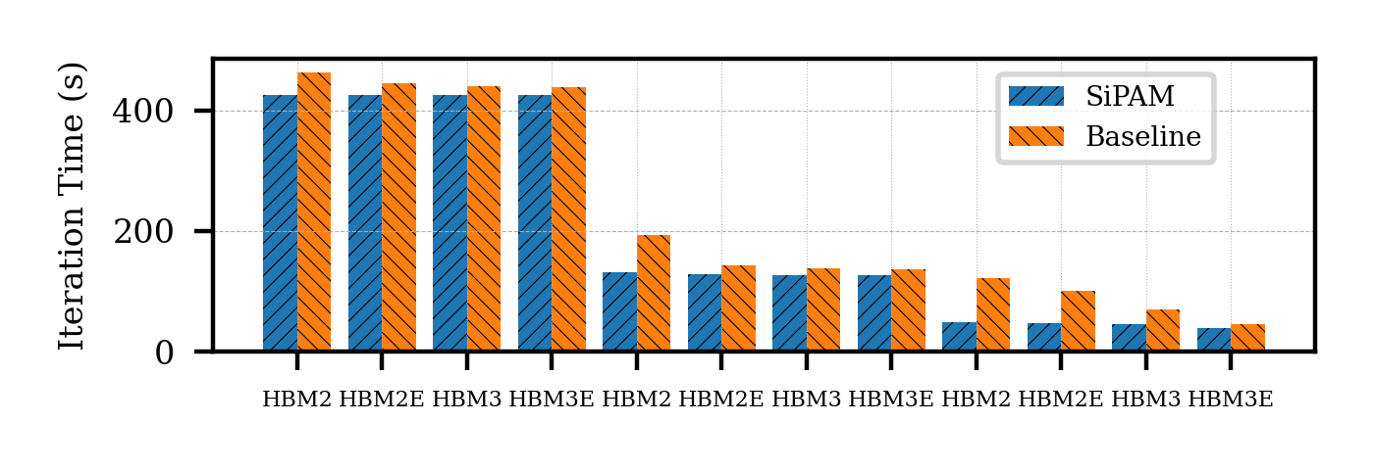
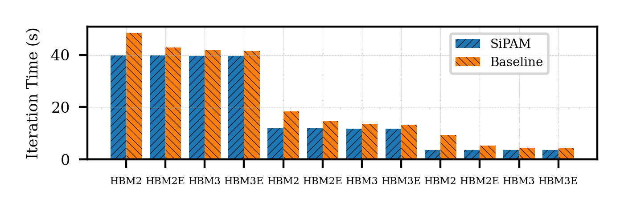
Compute & Memory Technology Scaling
Training
Configurations:
Workload: GPT3-175B
Network size: 128 GPUs
Cross GPU-HBM pairing
Takeaway: SiPAM consistently outperforms the baseline by allocating the needed compute and memory resources
Newer GPU generations outperform earlier ones.
For each GPU generation, performance improves as memory generation advances.
A100
H100
B100
Inference
A100
H100
B100

Slide 16
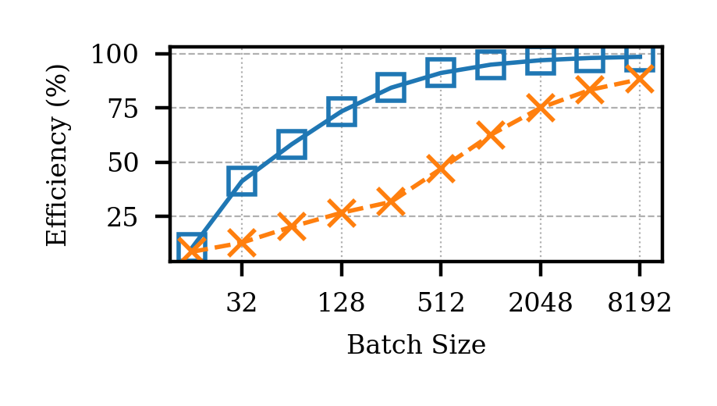
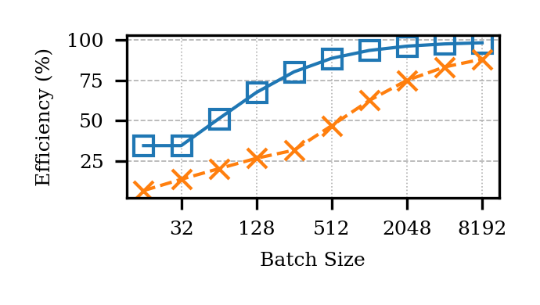
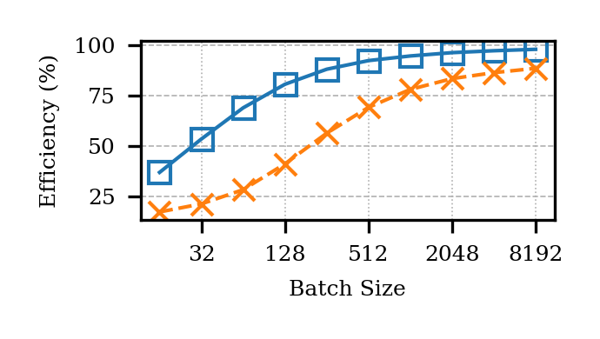
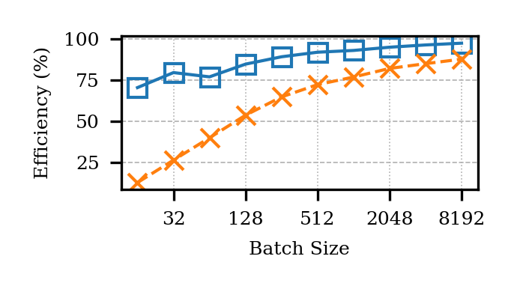

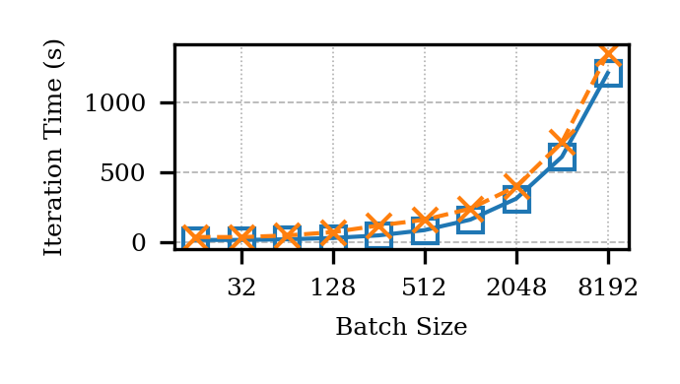
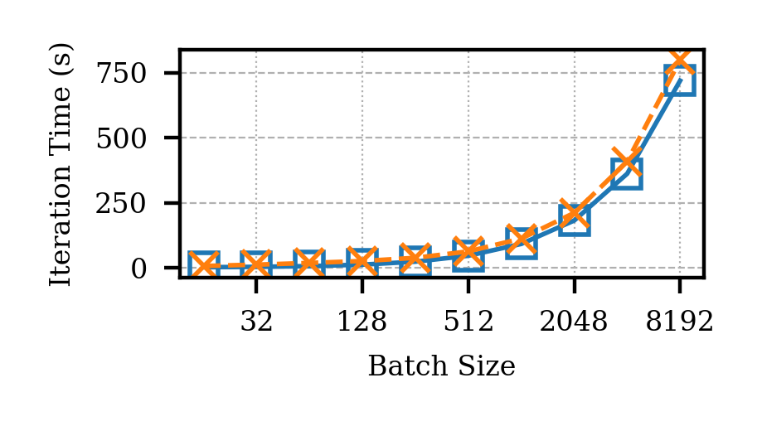
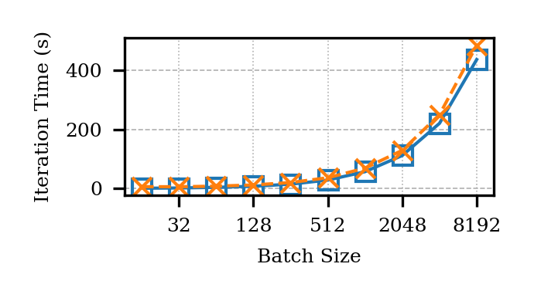
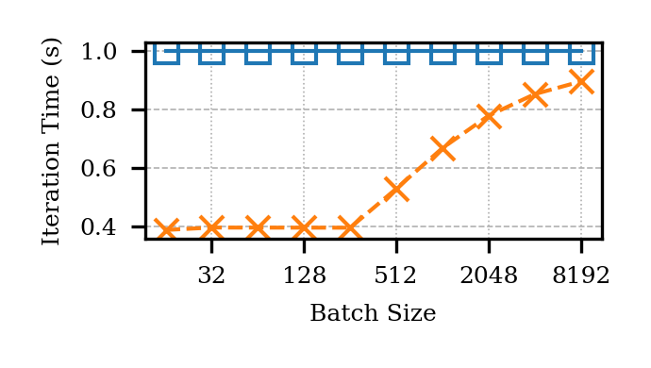
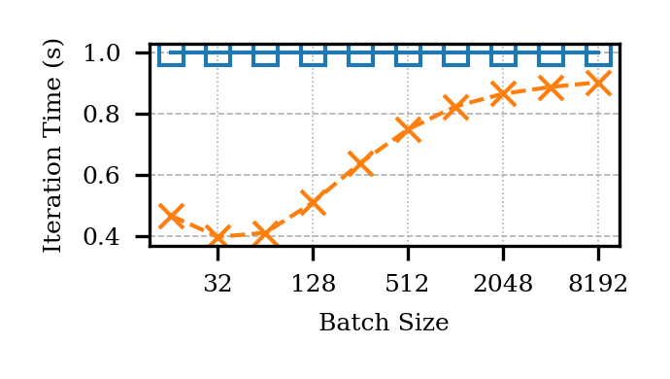
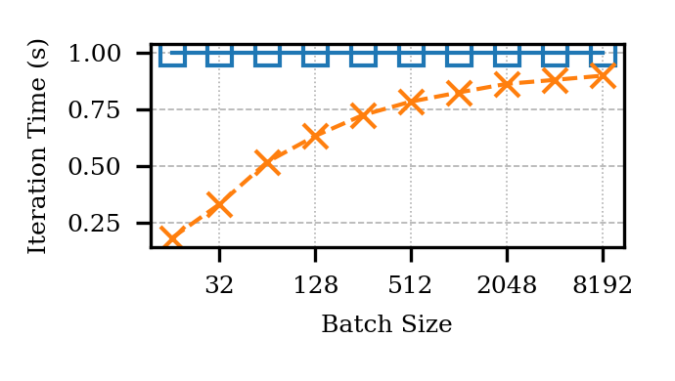
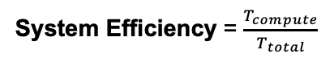
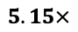
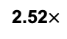
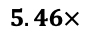
System Efficiency Analysis
Configurations:
Workload: Megatron-1T
Metrics: System Efficiency & Iteration Time (inset shows relative performance)
SiPAM consistently outperforms the baseline in both efficiency and iteration time.
System Efficiency = $\frac{T_{compute}}{T_{total}}$
A100 (HBM2)
H100 (HBM2E)
B100 (HBM3E)
2.52$×$
$$5.46×$$
$$5.15×$$
Relative Performance
Relative Performance
Relative Performance

Slide 17
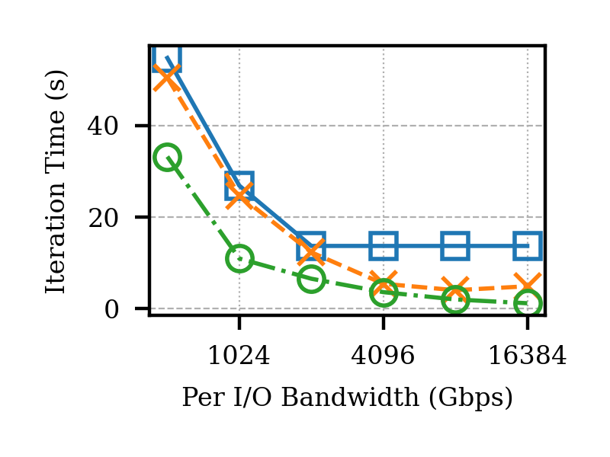
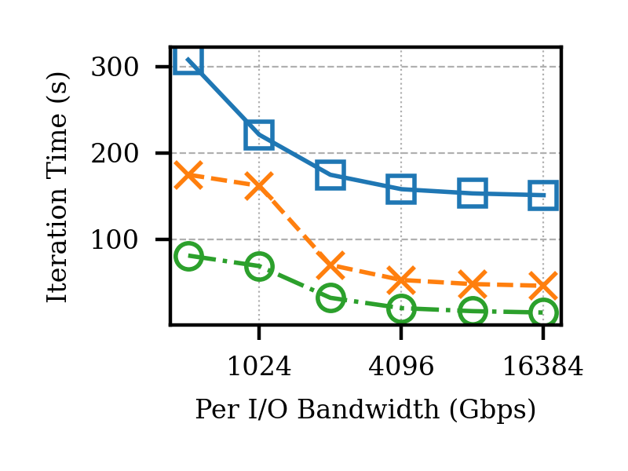
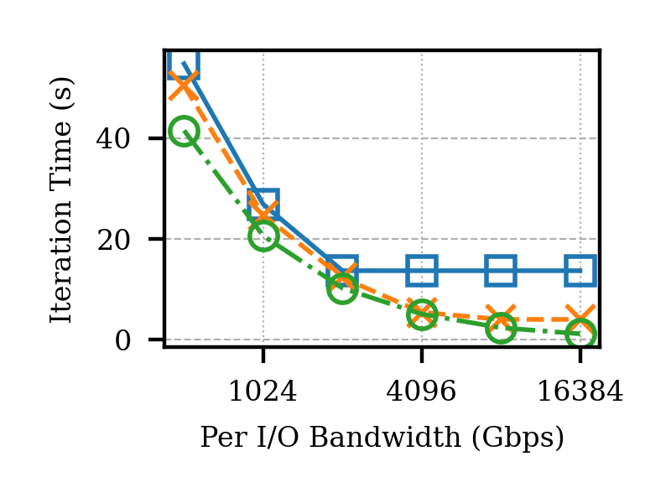
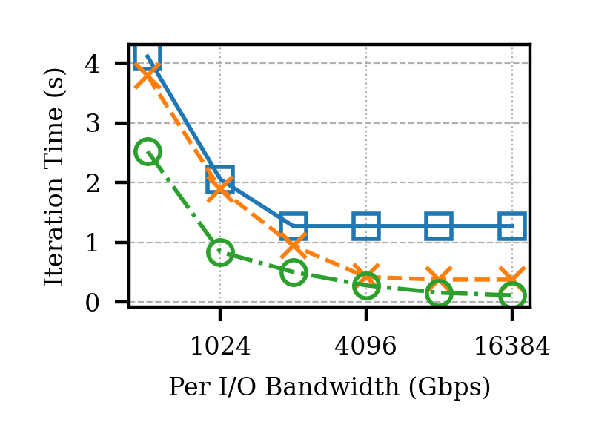

SiP I/O Bandwidth Scaling
Configurations:
Workload: Megatron-1T & Megatron-1T
Per I/O Bandwidth: 512 Gbps to 16 Tbps
Total injection bandwidth / GPU:
A100/H100: 6 Tbps to 192 Tbps
B100: 7.6 Tbps to 240 Tbps
Takeaway: Newer GPU generations with higher compute capability require greater memory bandwidth to achieve continued performance scaling.
A100 on Megatron-1B: performance plateaus
Compute throughput becomes saturated
Megatron-1B
Training
Megatron-1T
Training
Megatron-1B
Inference
Megatron-1T
Inference

Slide 18

Conclusion
Problems addressed: memory capacity & bandwidth bottlenecks in AI/ML
Design:
Direct photonic integration along the perimeter of the compute die
Unified high-bandwidth communication domain
Optimization: co-designed roofline-model based allocation algorithm
Results:
Showed up to 3.5x faster iteration time
Highlights the critical need for bandwidth scaling in next-generation compute.
Future Works:
Cost and power modeling
Capture network demand in addition to memory demand

Slide 19





















Acknowledgement
19

